Slide 1
MMVT Motors Layout design Presentation.

Slide 2
Main Page Ideas and layout
In making the website, our main goal was to make It easy to use, read and understand Although still giving it depth, as a website.
The website layout will stay the same throughout, Even if you are a staff, customer or visitor (Non-registered person).
There’s a staff section of the site, Which is used for assigning people to jobs and to show who works on which job, as well as adding new staff, viewing people’s details or reviewing already done jobs.

Slide 3
As you can see that is the main site, when someone isn’t logged in to the site, as there’s a “Log-in” and a “Register” Link in the main header.
Once you are logged in, The header changes so that there’s no “register” and no “Log-in” option due to the fact that you are already logged into the site as a registered customer/staff.

Slide 4
For registering, it’s very simple. There’s a terms and conditions on the left of the sign-up section. For then, it’s only needed for their personal details to be taken in, once they are registered, they are able to then register a vehicle so that they may start to make/cancel/change appointments.

Slide 5
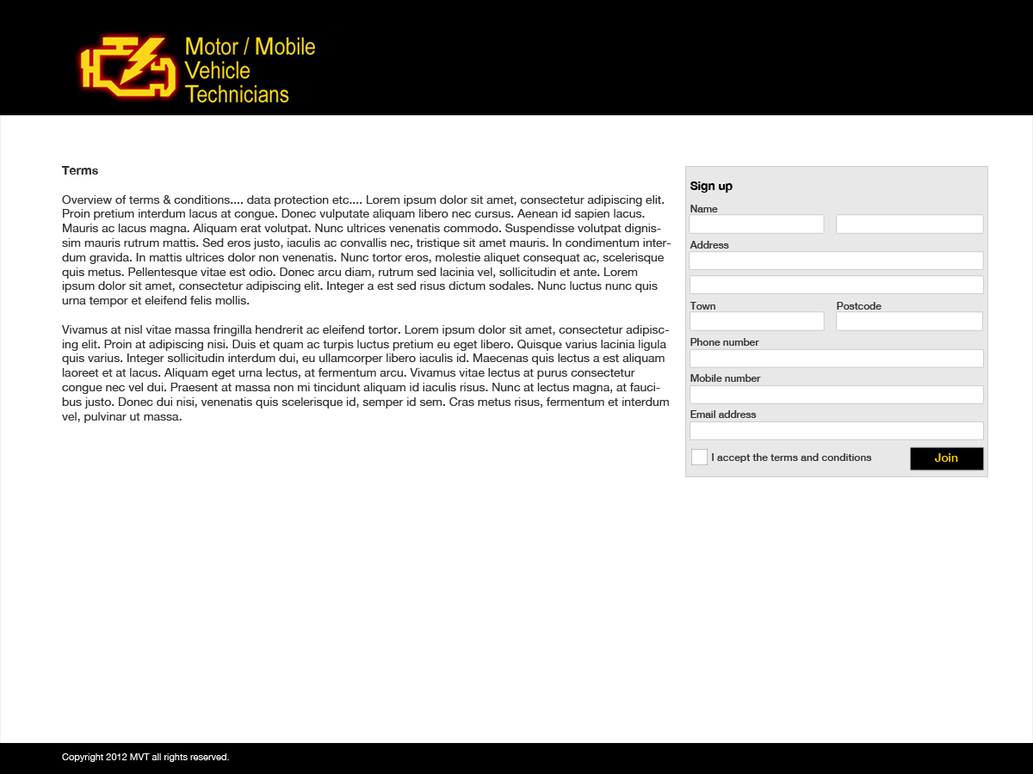
Sign-up Page

Slide 6
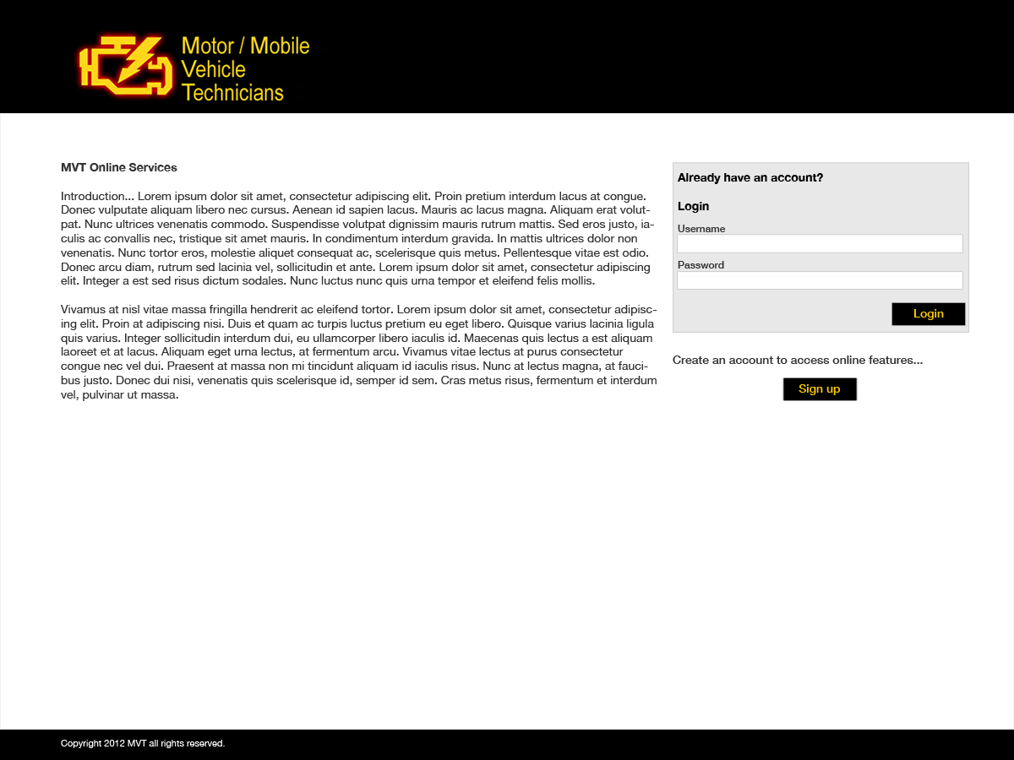
Sign-in page

Slide 7
Profile Page.
The customer must have the option to view and change their details, due to the law of the data protection act.
The interface for it is cleanly laid out so that you can do each part and select on the side which part is being filled out.

Slide 8
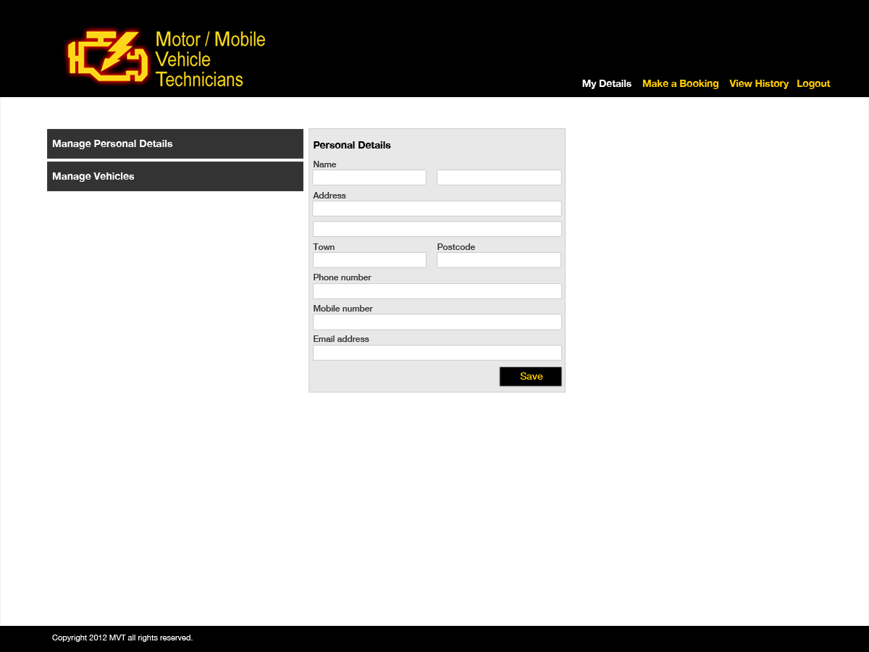
Profile page Screen. (Personal Details)

Slide 9
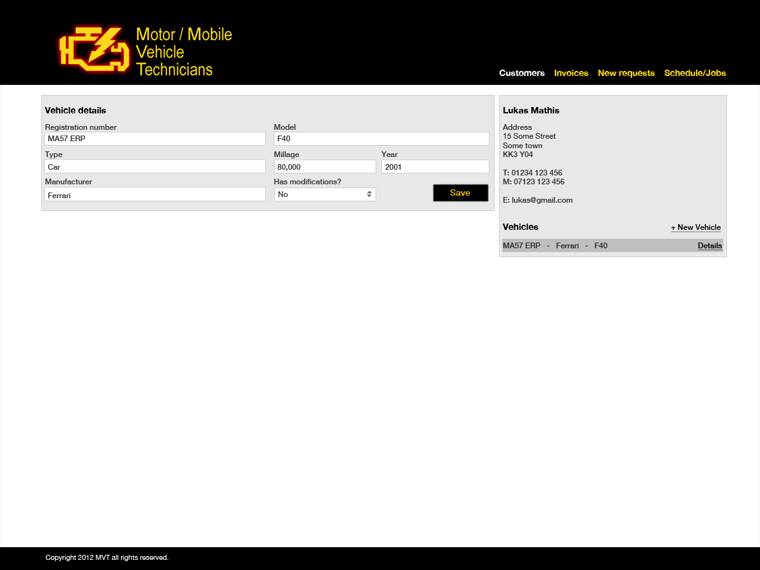
Profile page screen (Vehicle details to add)

Slide 10
Staff Pages
The Staff position on the site, gives control over making jobs, viewing jobs that are needing done, ones that have been done, and are able to make jobs, and claim ones which are available.
The next page is showing a page which you are able to view customer details, aswell as add new customers or details.

Slide 11
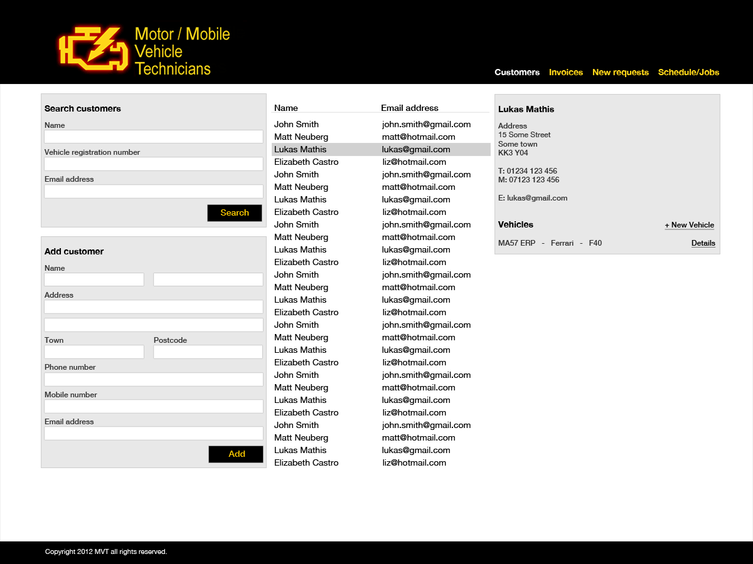

Slide 12
The Staff section has options to also show a calendar-like view of the jobs which are on.
This makes things very easy to understand and can be viewed in either daily, weekly or monthly
Here are examples of daily and monthly.

Slide 13
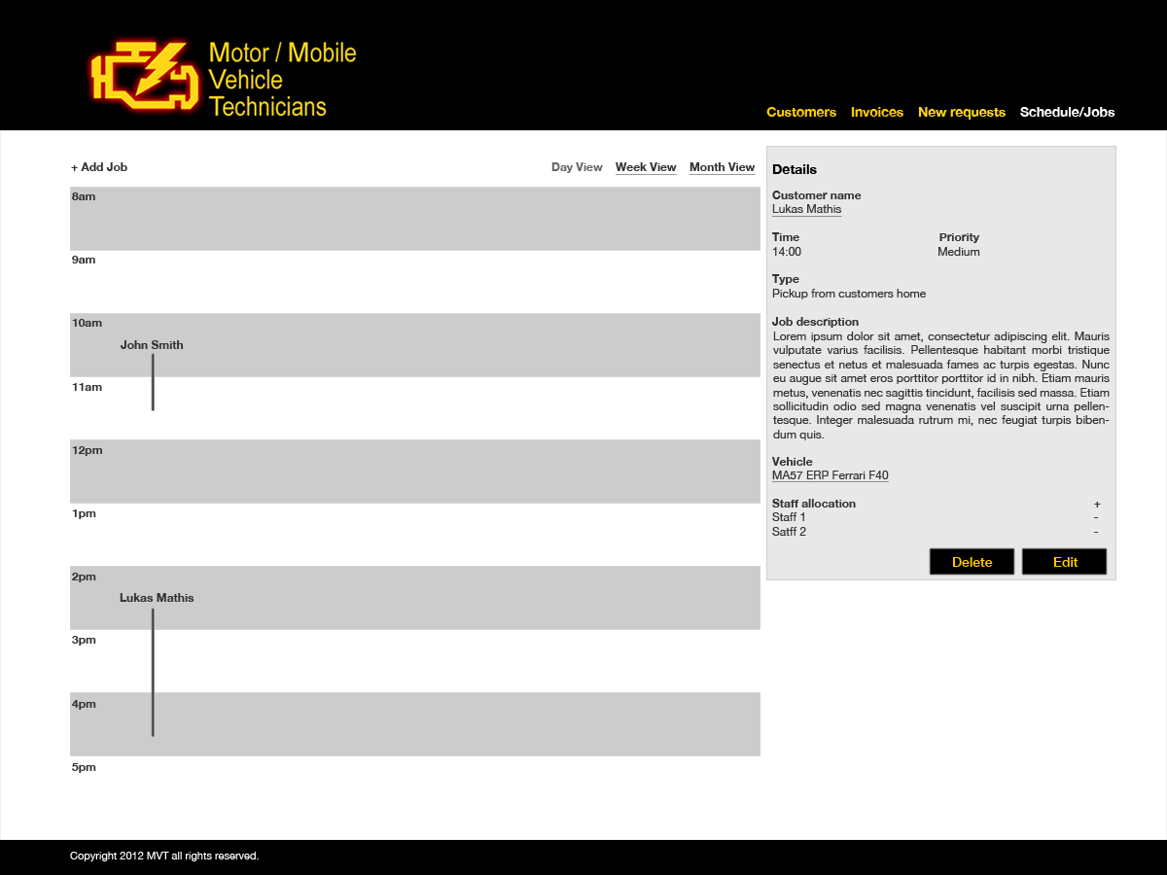
Daily Calendar example.

Slide 14
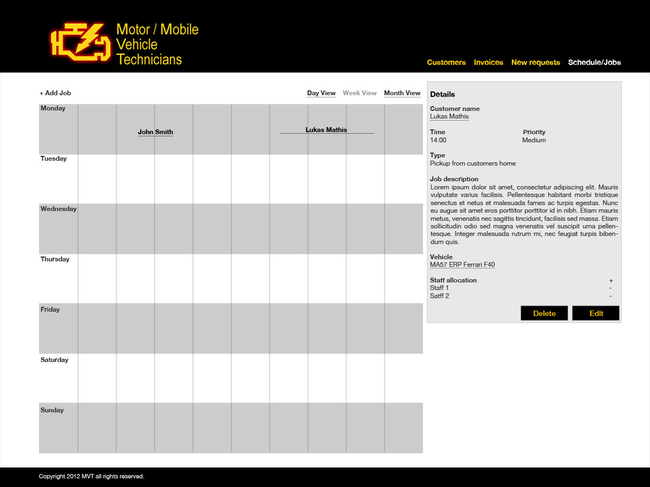
Weekly Calendar Example

Slide 15
The vehicle register screen for staff, is very simple. It just asks for the basic things which are things such as make, model and year, but also other needed information, for example, mileage and modifications.

Slide 16
Vehicle Registration screen

Slide 17
The Request screen is very simple, it just shows the appointment in which has been requested, and you are able to get it assigned to your schedule, or decline the request.

Slide 18
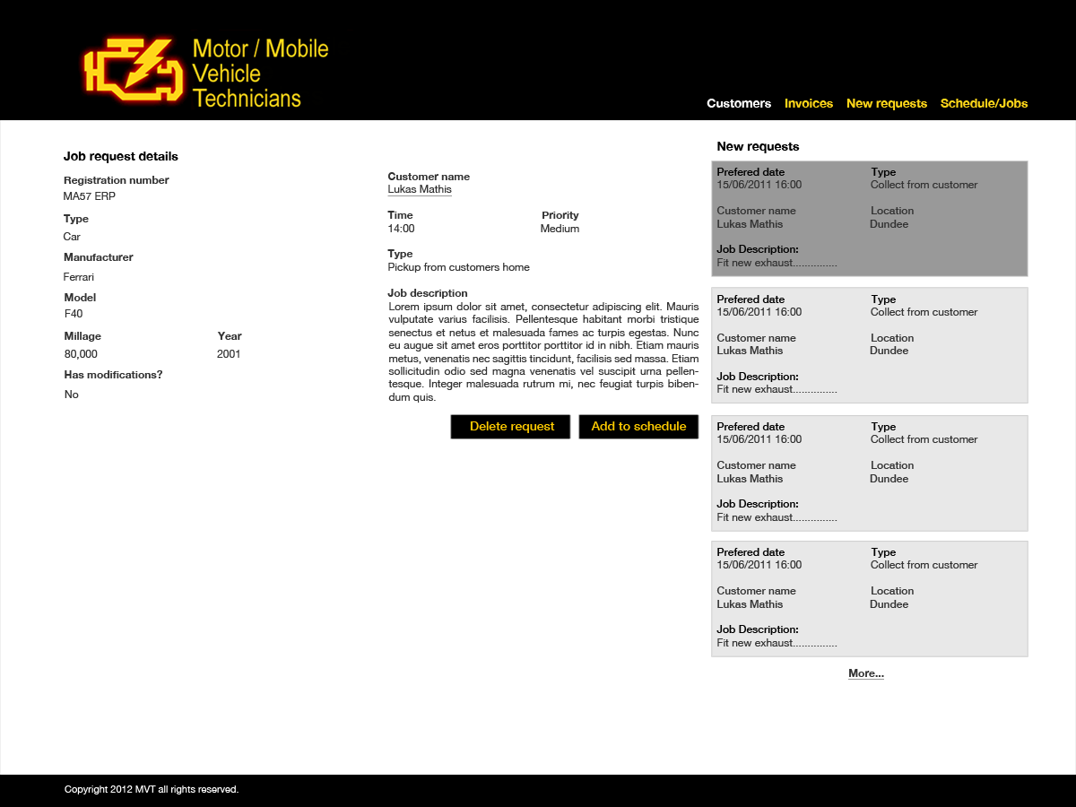
Request screen.

Slide 19
Invoices
The Invoice page is that of a receipt style, This makes it look much easier to manage and is easier to understand, as it is a layout which people are used to seeing.

Slide 20
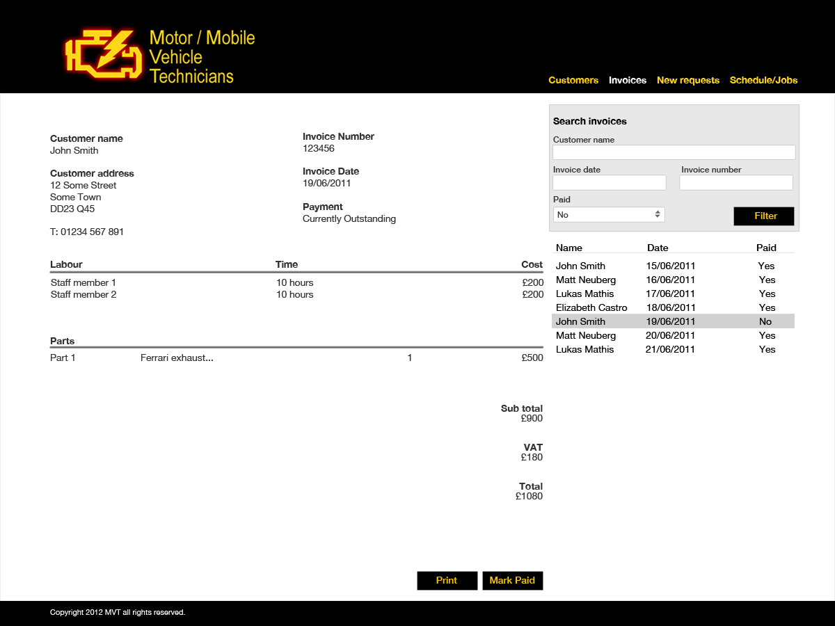
Invoice screen

Slide 21
Other statements.
Those are some examples over the concepts in which we have created, This presentation is just an explanation of some ideas, and to view the rest of the concept work, please refer to the files within the layout work folders for more details.

